Slide 1
ECEN 150 Circuit Analysis I
Capacitors and Inductors

Slide 2
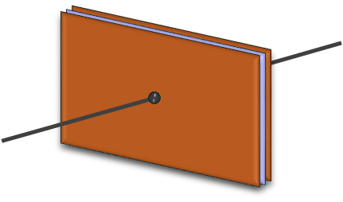
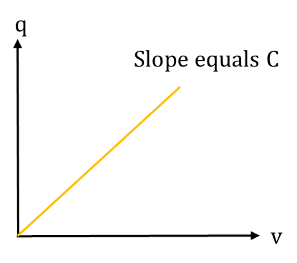
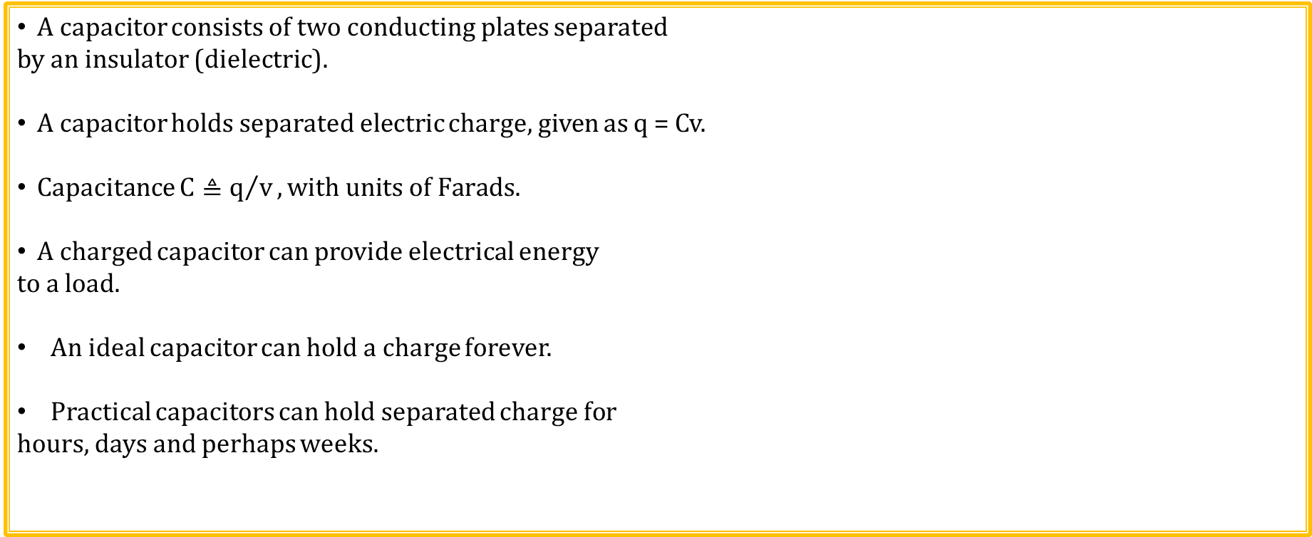
Capacitors
A capacitor consists of two conducting plates separated
by an insulator (dielectric).
A capacitor holds separated electric charge, given as q = Cv.
Capacitance $C≜q/v, with units of Farads.$
A charged capacitor can provide electrical energy
to a load.
An ideal capacitor can hold a charge forever.
Practical capacitors can hold separated charge for
hours, days and perhaps weeks.

Slide 3
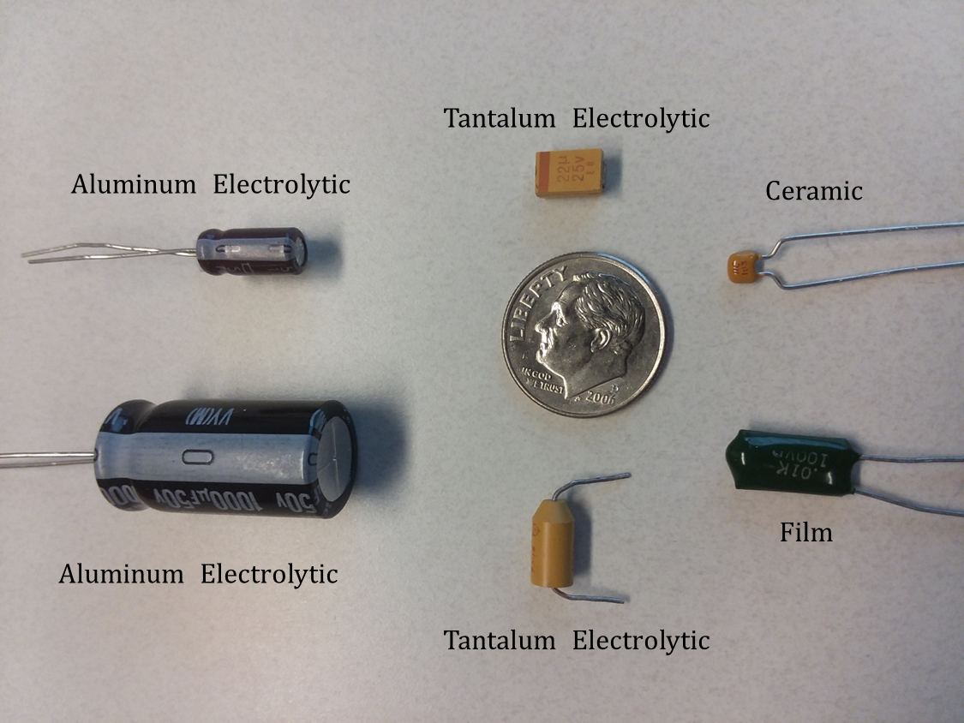
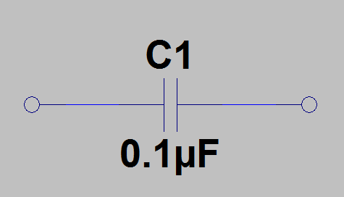
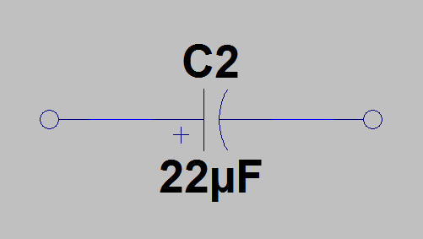
Common Capacitor Types and Symbols
Don’t need to worry about voltage polarity across non-polarized capacitors such as film and ceramic capacitors, which simplifies their usage.
Electrolytic capacitors use either a liquid or solid electrolyte to achieve a large capacitance per area, which is good.
However, electrolytic capacitors are polarized, meaning that connecting to the proper voltage polarity is necessary.
Incorrect voltage polarity applied across an electrolytic capacitor can cause current flow resulting in heating that eventually can destroy the capacitor.
While the large capacitance per area of electrolytic capacitors has benefitted the electronics industry, electrolytic capacitors inadvertently installed backwards have plagued and continue to plague the industry.
Non-Polarized
Capacitor Schematic
Symbol
Polarized Capacitor Schematic
Symbol

Slide 4
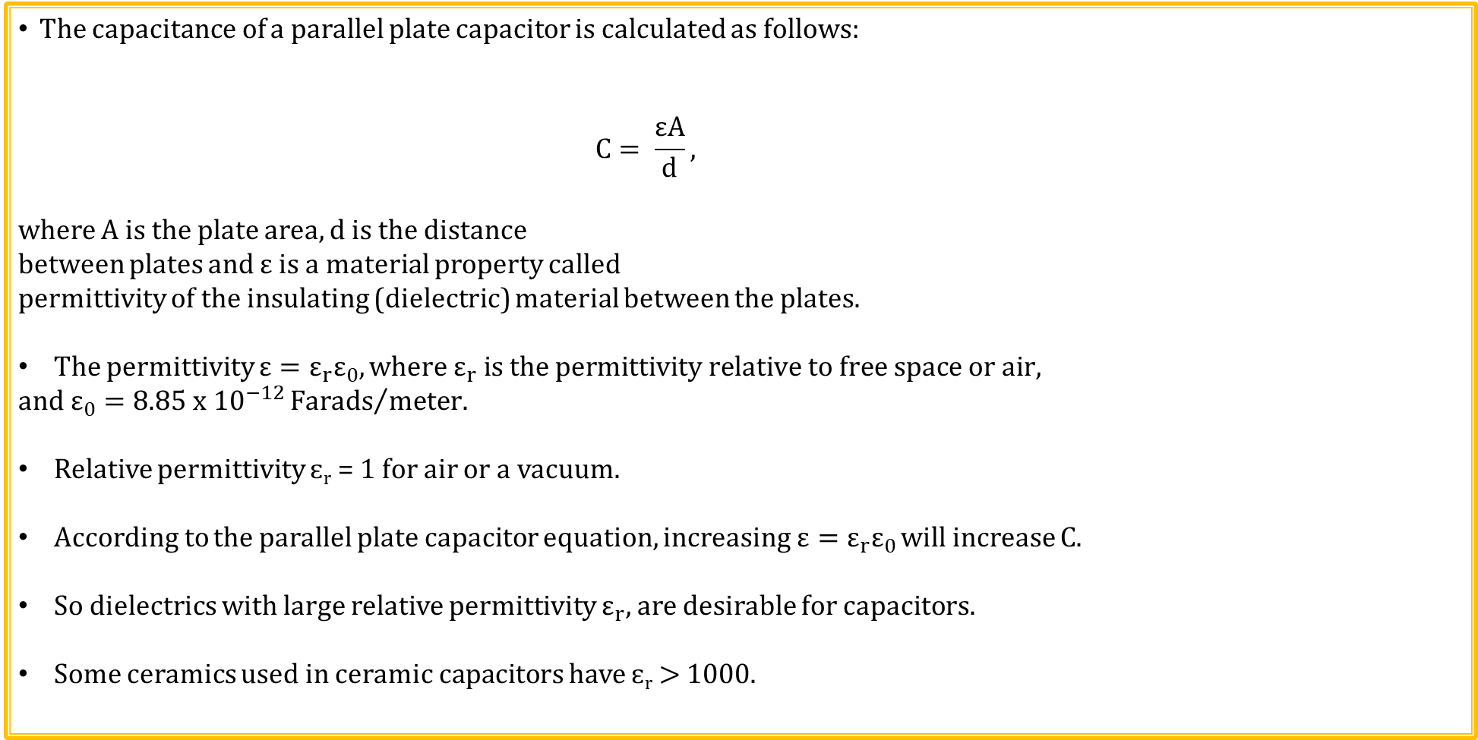
Capacitors (Continued)
+
+
+
+
+
+
+
+
+
+
+
+
+
+
+
+
+
+
+
+
+
+
+
+
+
+
The capacitance of a parallel plate capacitor is calculated as follows:
$$C= \frac{εA}{d},$$
where A is the plate area, d is the distance
between plates and ε is a material property called
permittivity of the insulating (dielectric) material between the plates.
The permittivity $ε=ε_{r}ε_{0}, where ε_{r} is the permittivity relative to free space or air,$
$$and ε_{0}=8.85{ x 10}^{−12}{Farads}/{meter.}$$
Relative permittivity ɛ_{r} = 1 for air or a vacuum.
According to the parallel plate capacitor equation, increasing $ε=ε_{r}ε_{0}$ will increase C.
So dielectrics with large relative permittivity $ε_{r},$ are desirable for capacitors.
Some ceramics used in ceramic capacitors have ɛ_{r} > 1000.
Cross-Section of Rectangular Parallel Plate Capacitor
+q charge on top plate
Distance
between
Plates: d
E
_
_
_
_
_
_
_
_
_
_
_
_
_
_
_
_
_
_
_
_
_
_
_
_
_
_
-q charge on bottom plate

Slide 5
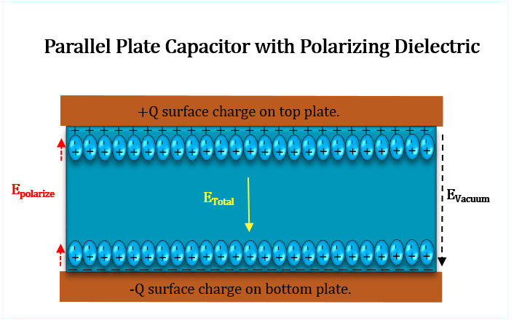
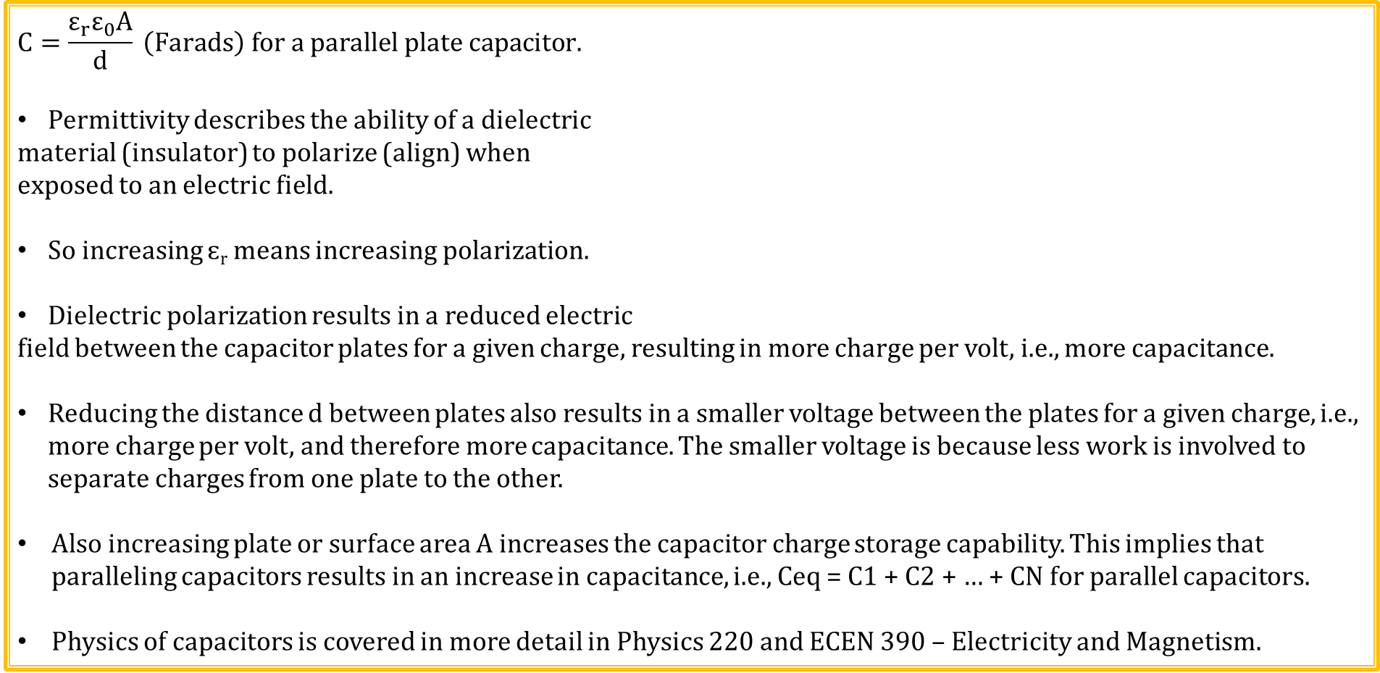
Capacitors (Continued)
$$C=\frac{ε_{r}ε_{0}\text{A}}{\text{d}} \left(Farads\right) for a parallel plate capacitor.$$
Permittivity describes the ability of a dielectric
material (insulator) to polarize (align) when
exposed to an electric field.
So increasing ɛ_{r} means increasing polarization.
Dielectric polarization results in a reduced electric
field between the capacitor plates for a given charge, resulting in more charge per volt, i.e., more capacitance.
Reducing the distance d between plates also results in a smaller voltage between the plates for a given charge, i.e., more charge per volt, and therefore more capacitance. The smaller voltage is because less work is involved to separate charges from one plate to the other.
Also increasing plate or surface area A increases the capacitor charge storage capability. This implies that paralleling capacitors results in an increase in capacitance, i.e., Ceq = C1 + C2 + … + CN for parallel capacitors.
Physics of capacitors is covered in more detail in Physics 220 and ECEN 390 – Electricity and Magnetism.

Slide 6
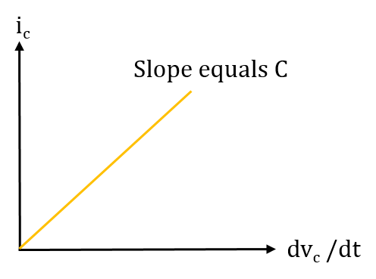
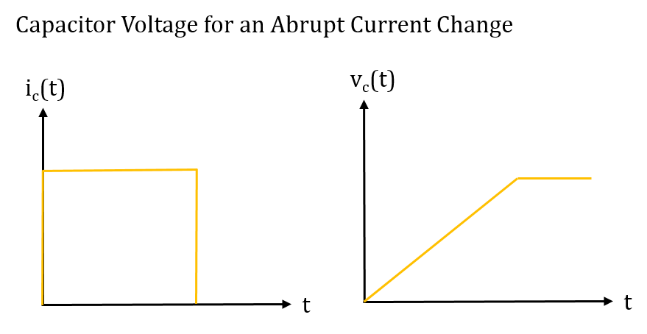
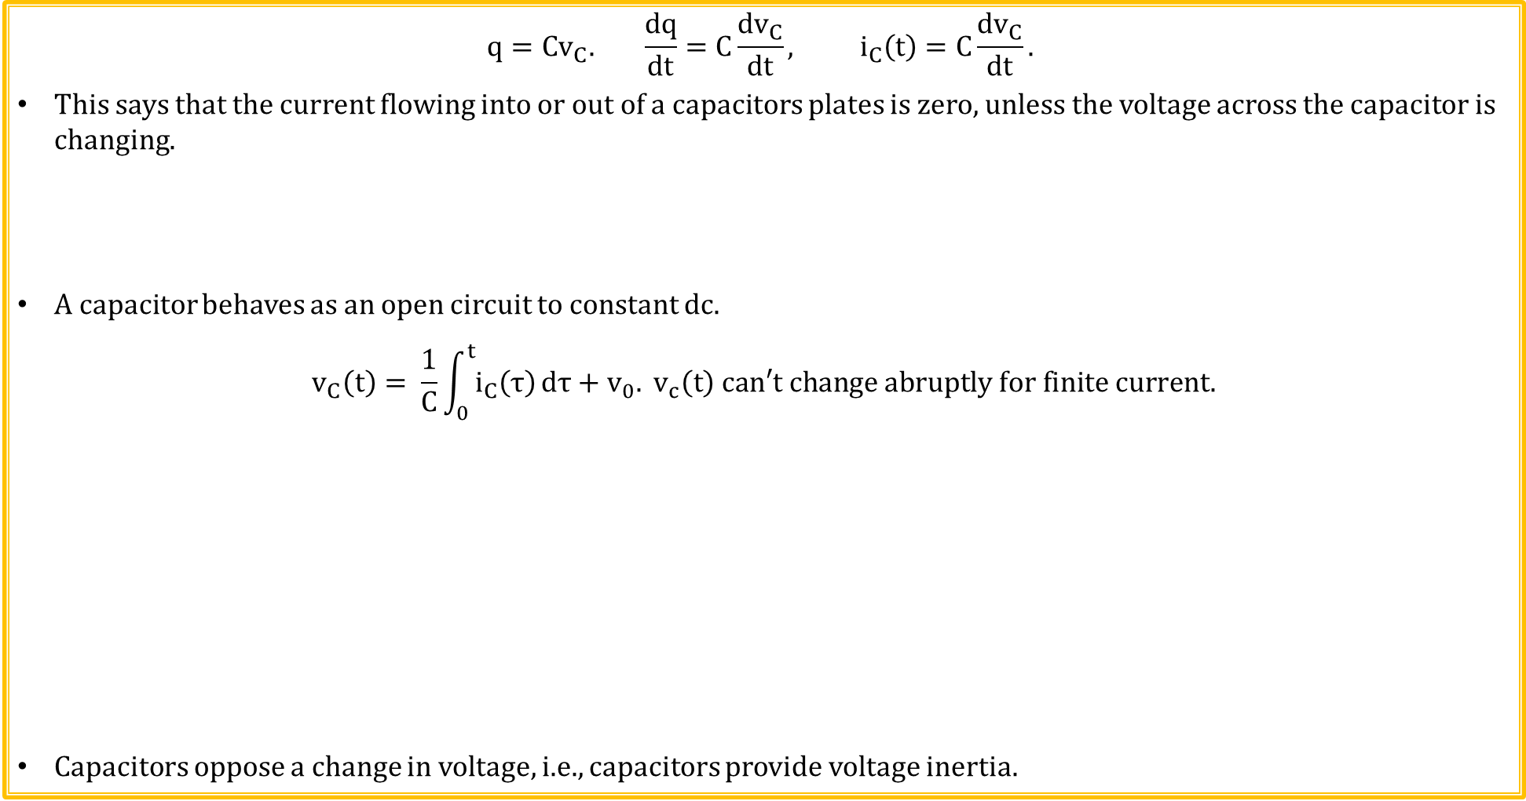
Capacitor Current and Voltage
$$q=Cv_{C}. \frac{dq}{dt}=C\frac{dv_{C}}{dt}, i_{C}\left(t\right)=C\frac{dv_{C}}{dt}.$$
This says that the current flowing into or out of a capacitors plates is zero, unless the voltage across the capacitor is changing.
A capacitor behaves as an open circuit to constant dc.
$$v_{C}\left(t\right)= \frac{1}{C}\int_{0}^{t}{i_{C}\left(τ\right)}dτ+v_{0}. v_{c}\left(t\right) can′t change abruptly for finite current.$$
Capacitors oppose a change in voltage, i.e., capacitors provide voltage inertia.

Slide 7
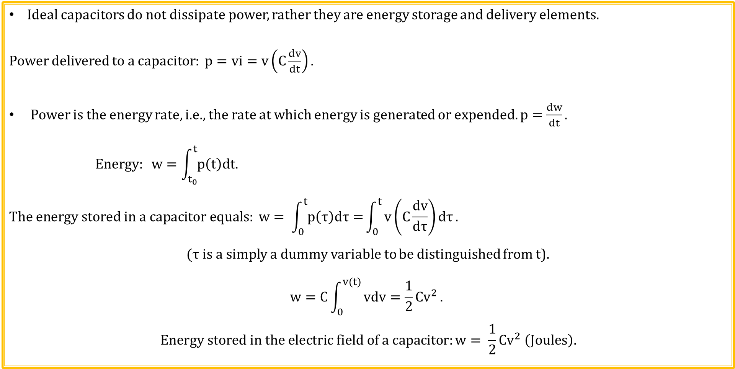
Capacitor Energy Storage
Ideal capacitors do not dissipate power, rather they are energy storage and delivery elements.
Power delivered to a capacitor: $p=vi=v\left(C\frac{dv}{dt}\right).$
Power is the energy rate, i.e., the rate at which energy is generated or expended. $p=\frac{dw}{dt}.$
$$Energy: w=\int_{t_{0}}^{t}{p\left(t\right)dt.}$$
$$The energy stored in a capacitor equals: w= \int_{0}^{t}{p\left(τ\right)dτ=}\int_{0}^{t}{v\left(C\frac{dv}{dτ}\right)dτ}.$$
$(τ$ is a simply a dummy variable to be distinguished from t).
$$w=C\int_{0}^{v(t)}{vdv=\frac{1}{2}{Cv}^{2}}.$$
$$Energy stored in the electric field of a capacitor:w= \frac{1}{2}Cv^{2} \left(Joules\right).$$

Slide 8
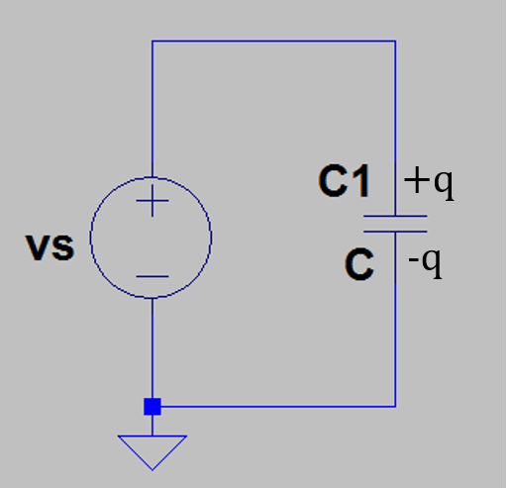
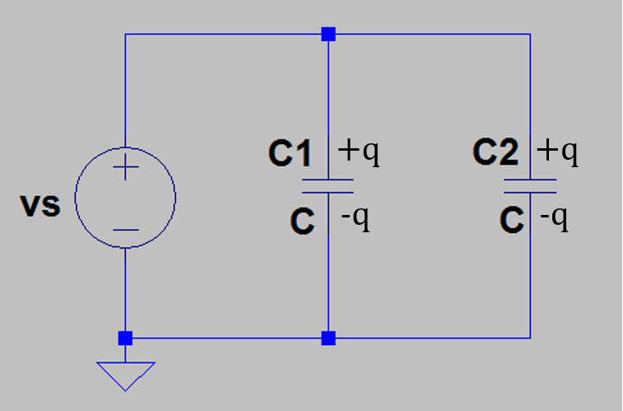
Parallel Capacitors
Adjacent capacitor of value C charges to voltage v_{s}, resulting ina charge of
q = Cv_{s} on the top plate and a charge of – Cv_{s} on the bottom plate.
Add a second capacitor C2 of value C in parallel with C1 and the
resulting charge stored in the circuit is doubled. Overall charge stored
on the top plates of C1 and C2 now equals 2Cv_{s}. Overall circuit behaves
as if an equivalent capacitor Ceq = 2C were connected across the source
voltage v_{s}. So equivalent capacitance of two parallel capacitors each of
value C equals 2C.
For N capacitors connected in parallel: Ceq = C1 + C2 + …. CN.
Capacitors in parallel add the same as resistors in series.

Slide 9
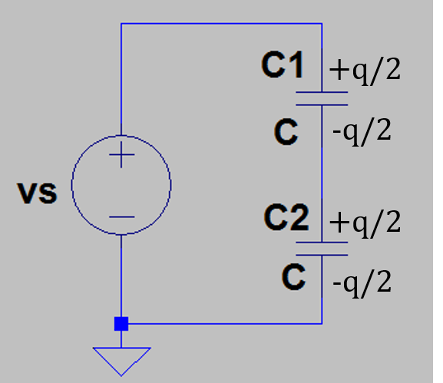
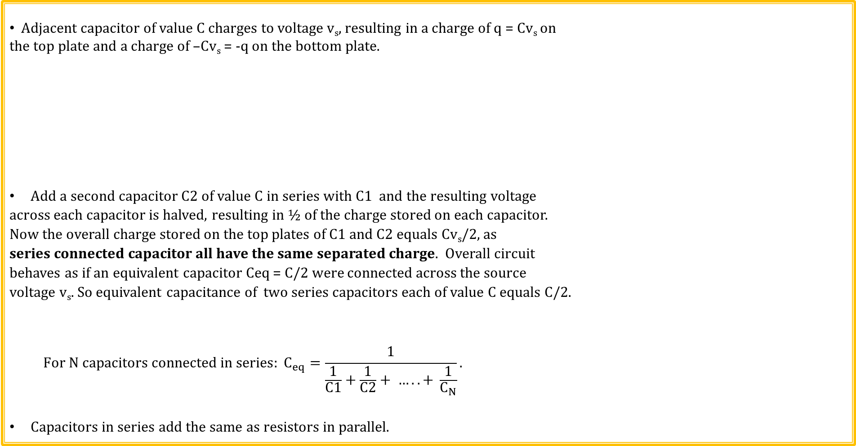
Series Capacitors
Adjacent capacitor of value C charges to voltage v_{s}, resulting in a charge of q = Cv_{s} on
the top plate and a charge of –Cv_{s} = -q on the bottom plate.
Add a second capacitor C2 of value C in series with C1 and the resulting voltage
across each capacitor is halved, resulting in ½ of the charge stored on each capacitor.
Now the overall charge stored on the top plates of C1 and C2 equals Cv_{s}/2, as
series connected capacitor all have the same separated charge. Overall circuit
behaves as if an equivalent capacitor Ceq = C/2 were connected across the source
voltage v_{s}. So equivalent capacitance of two series capacitors each of value C equals C/2.
$${For N capacitors connected in series: C}_{eq}=\frac{1}{\frac{1}{C1}+\frac{1}{C2}+ ….. + \frac{1}{C_{N}}}.$$
Capacitors in series add the same as resistors in parallel.
Poll Questions

Slide 10
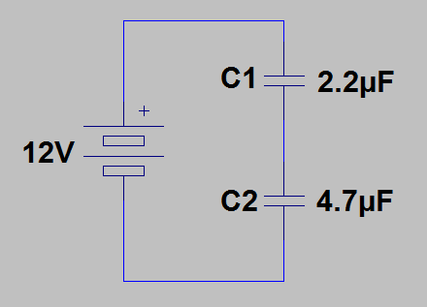
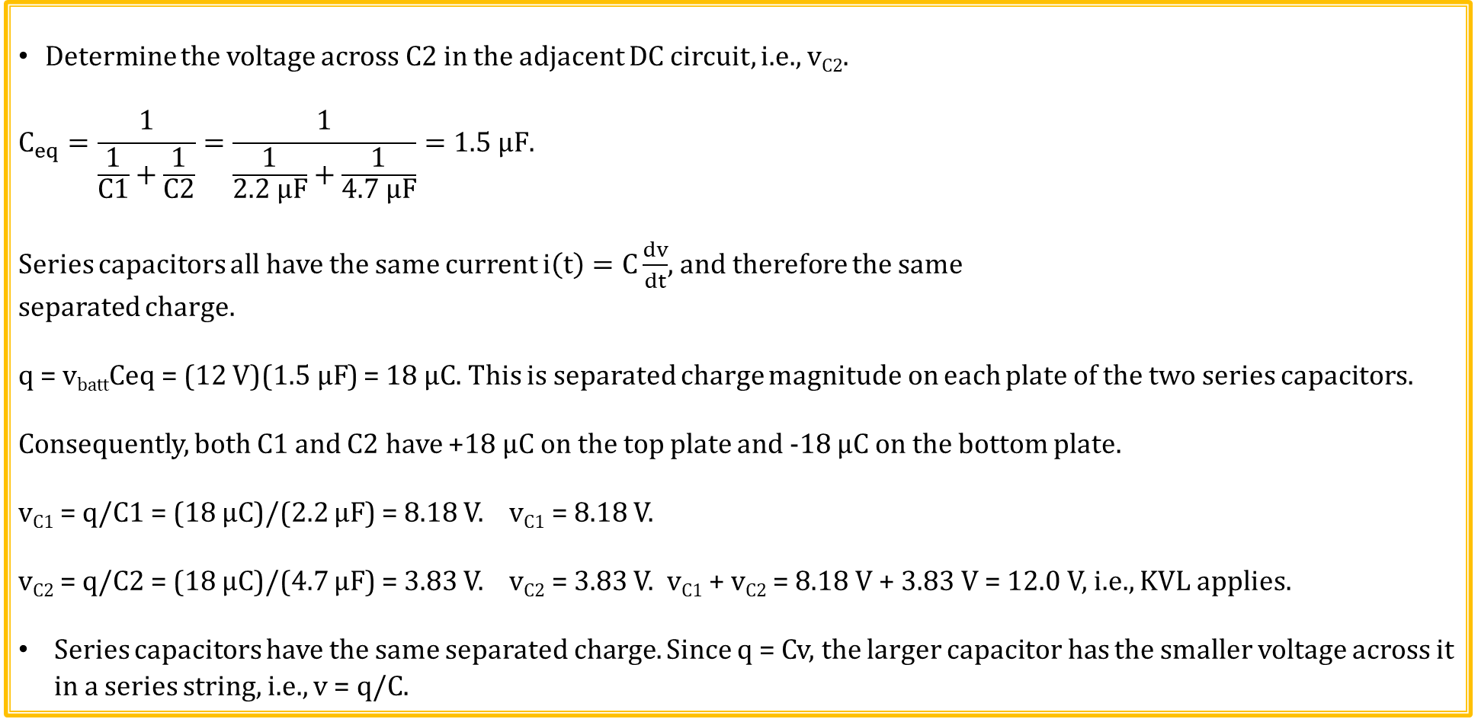
Series Capacitor Example
Determine the voltage across C2 in the adjacent DC circuit, i.e., v_{C2}.
$$C_{eq}=\frac{1}{\frac{1}{C1}+\frac{1}{C2}}=\frac{1}{\frac{1}{2.2 µF}+\frac{1}{4.7 µF}}=1.5 µF.$$
Series capacitors all have the same current $i\left(t\right)=C\frac{dv}{dt}$, and therefore the same
separated charge.
q = v_{batt}Ceq = (12 V)($1.5 µF$) = 18 µC. This is separated charge magnitude on each plate of the two series capacitors.
Consequently, both C1 and C2 have +18 µC on the top plate and -18 µC on the bottom plate.
v_{C1} = q/C1 = (18 µC)/(2.2 µF) = 8.18 V. v_{C1} = 8.18 V.
v_{C2} = q/C2 = (18 µC)/(4.7 µF) = 3.83 V. v_{C2} = 3.83 V. v_{C1} + v_{C2} = 8.18 V + 3.83 V = 12.0 V, i.e., KVL applies.
Series capacitors have the same separated charge. Since q = Cv, the larger capacitor has the smaller voltage across it in a series string, i.e., v = q/C.

Slide 11
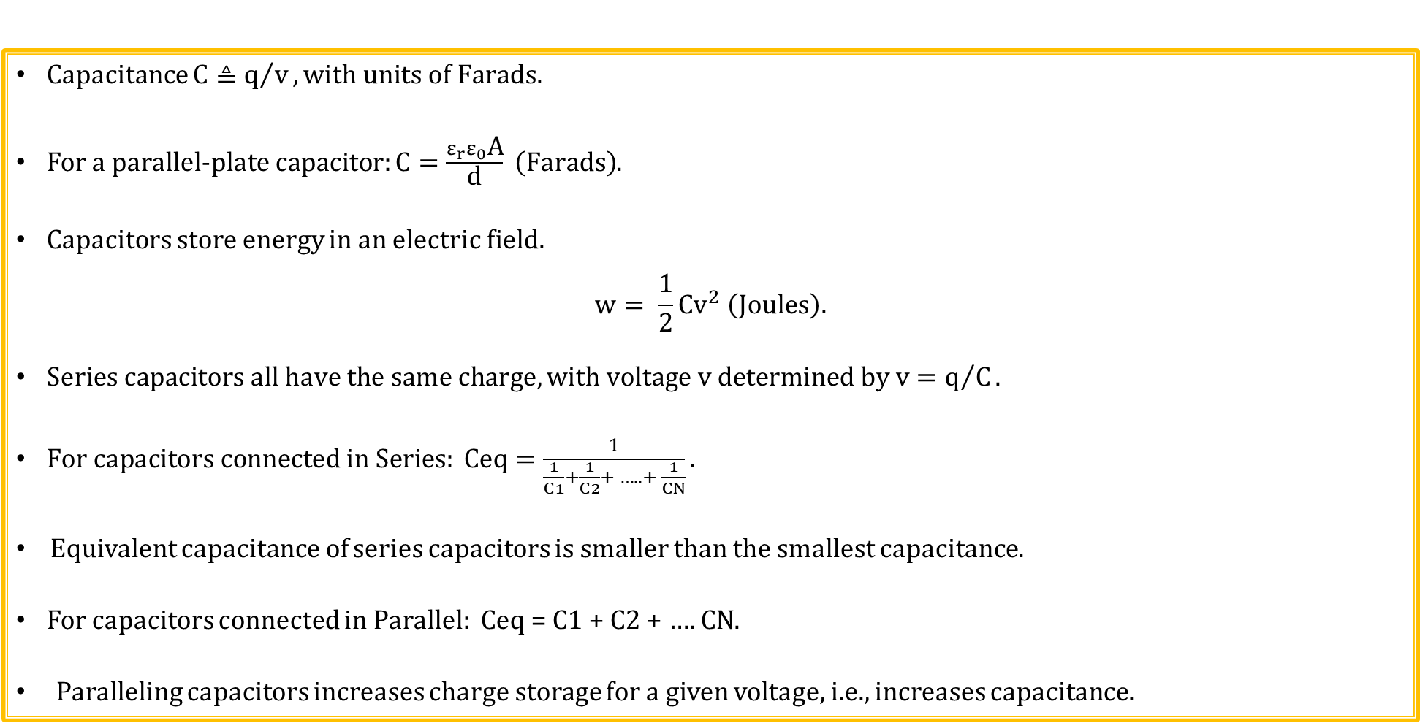
Capacitor Summary
Capacitance $C≜q/v, with units of Farads.$
For a parallel-plate capacitor: $C=\frac{ε_{r}ε_{0}\text{A}}{\text{d}} \left(Farads\right)$.
Capacitors store energy in an electric field.
$$w= \frac{1}{2}Cv^{2} \left(Joules\right).$$
$Series capacitors all have the same charge, with voltage v determined by v=q/C.$
$For capacitors connected in Series: Ceq=\frac{1}{\frac{1}{C1}+\frac{1}{C2}+ ….. + \frac{1}{CN}}.$
Equivalent capacitance of series capacitors is smaller than the smallest capacitance.
For capacitors connected in Parallel: Ceq = C1 + C2 + …. CN.
Paralleling capacitors increases charge storage for a given voltage, i.e., increases capacitance.

Slide 12
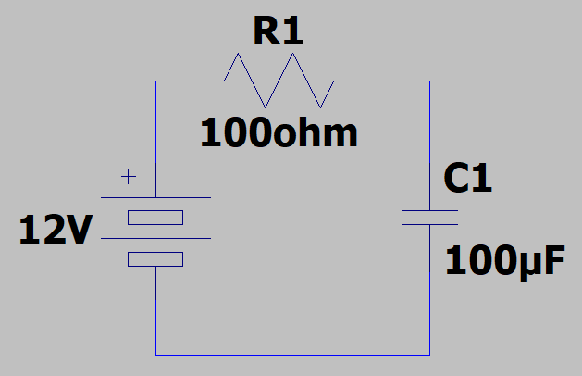
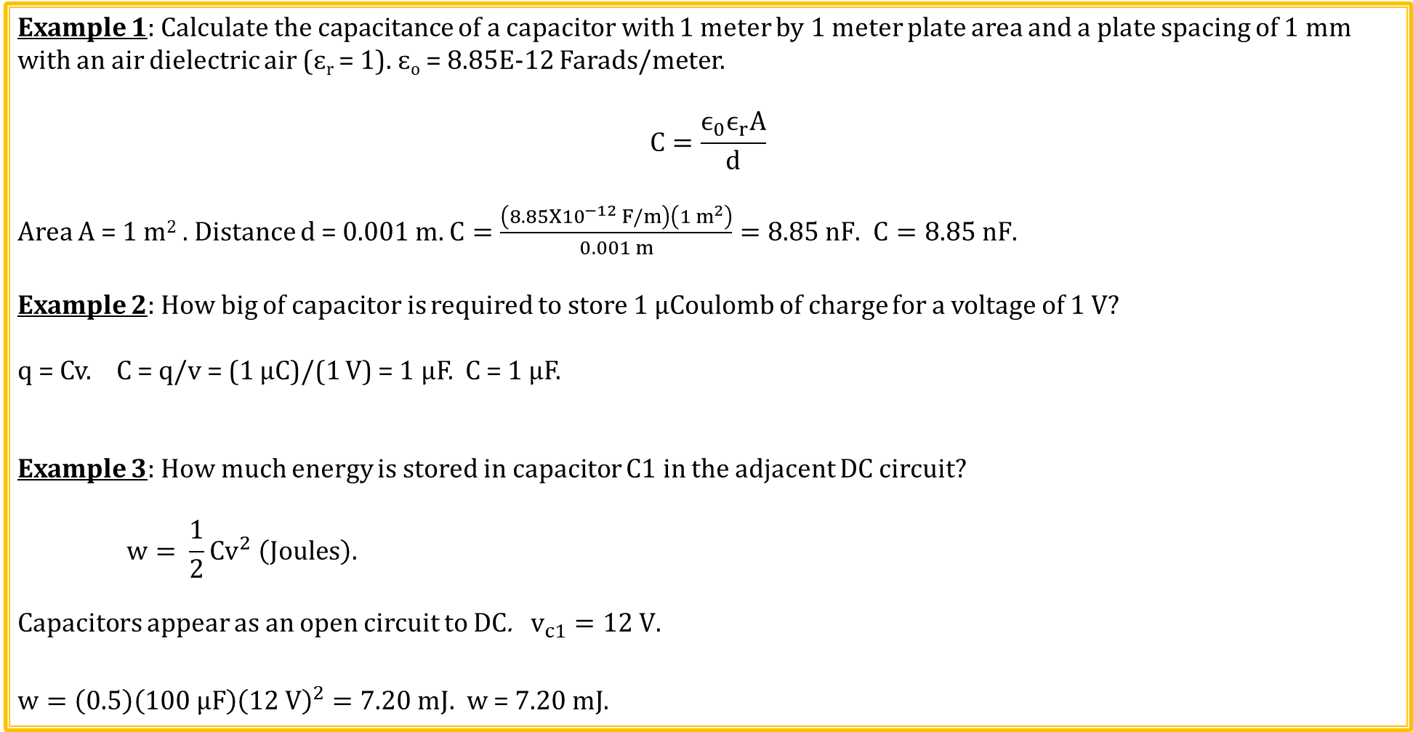
Capacitance Calculation Examples
Example 1: Calculate the capacitance of a capacitor with 1 meter by 1 meter plate area and a plate spacing of 1 mm with an air dielectric air (ɛ_{r} = 1). ɛ_{o} = 8.85E-12 Farads/meter.
$$C=\frac{ϵ_{0}ϵ_{r}A}{d}$$
Area A = 1 m² . Distance d = 0.001 m. $C=\frac{\left(8.85X{10}^{−12} F/m\right)\left(1 m^{2}\right)}{0.001 m}=8.85 nF.$ $C=8.85 nF.$
Example 2: How big of capacitor is required to store 1 µCoulomb of charge for a voltage of 1 V?
q = Cv. C = q/v = (1 µC)/(1 V) = 1 µF. C = 1 µF.
Example 3: How much energy is stored in capacitor C1 in the adjacent DC circuit?
$$w= \frac{1}{2}Cv^{2} \left(Joules\right).$$
Capacitors appear as an open circuit to DC. $v_{c1}=12 V.$
$w=\left(0.5\right)\left(100 μF\right){\left(12 V\right)}^{2}=7.20 mJ.$ w = $7.20 mJ.$

Slide 13
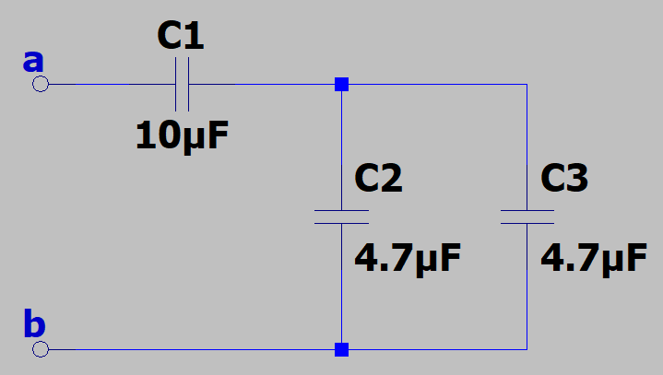
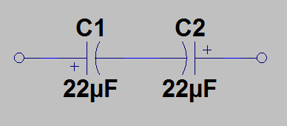
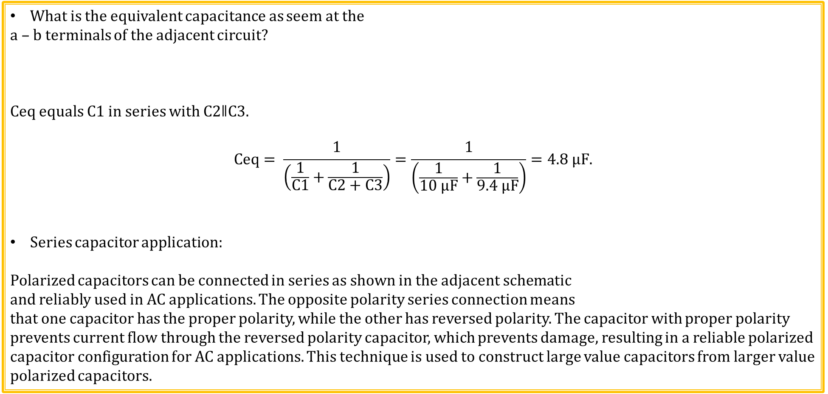
Equivalent Capacitance Examples
What is the equivalent capacitance as seem at the
a – b terminals of the adjacent circuit?
Ceq equals C1 in series with C2ǁC3.
$$Ceq= \frac{1}{\left(\frac{1}{C1}+\frac{1}{C2+C3}\right)}=\frac{1}{\left(\frac{1}{10 μF}+\frac{1}{9.4 μF}\right)}=4.8 μF.$$
Series capacitor application:
Polarized capacitors can be connected in series as shown in the adjacent schematic
and reliably used in AC applications. The opposite polarity series connection means
that one capacitor has the proper polarity, while the other has reversed polarity. The capacitor with proper polarity prevents current flow through the reversed polarity capacitor, which prevents damage, resulting in a reliable polarized capacitor configuration for AC applications. This technique is used to construct large value capacitors from larger value polarized capacitors.

Slide 14
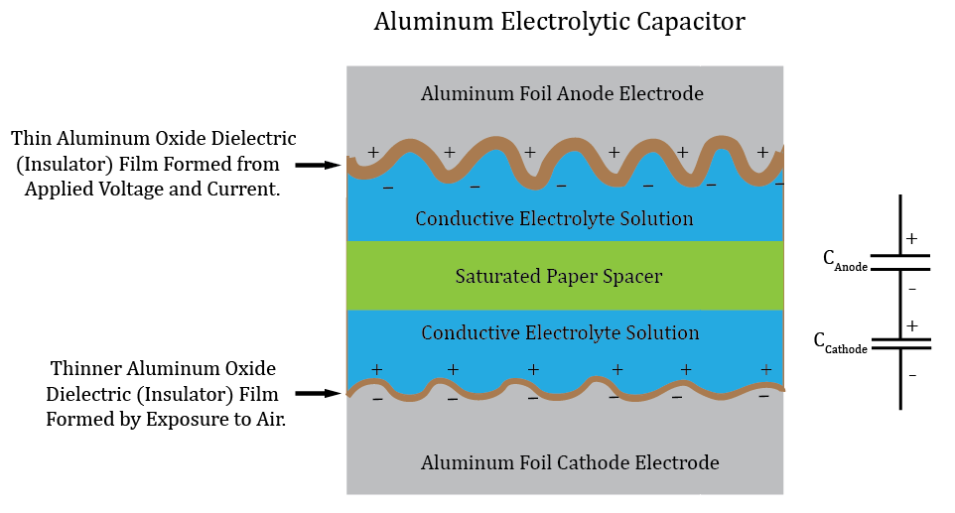
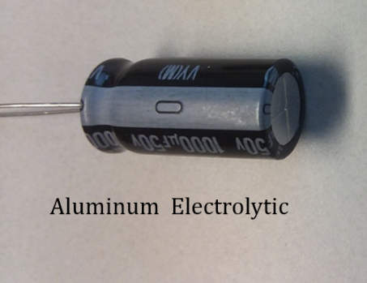
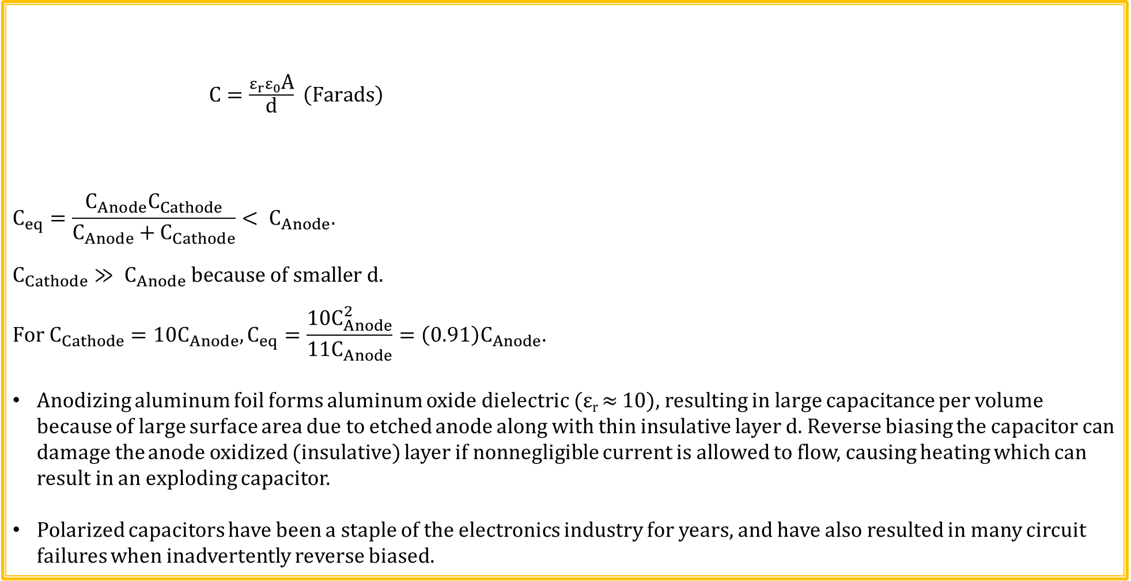
Aluminum Electrolytic Capacitors
$C=\frac{ε_{r}ε_{0}\text{A}}{\text{d}} \left(Farads\right)$
$$C_{eq}=\frac{C_{Anode}C_{Cathode}}{C_{Anode}+C_{Cathode}}< C_{Anode}.$$
$$C_{Cathode}≫ C_{Anode} because of smaller d.$$
$$For C_{Cathode}=10C_{Anode}, C_{eq}=\frac{10C_{Anode}^{2}}{11C_{Anode}}=\left(0.91\right)C_{Anode}.$$
Anodizing aluminum foil forms aluminum oxide dielectric (ε_{r} ≈ 10), resulting in large capacitance per volume because of large surface area due to etched anode along with thin insulative layer d. Reverse biasing the capacitor can damage the anode oxidized (insulative) layer if nonnegligible current is allowed to flow, causing heating which can result in an exploding capacitor.
Polarized capacitors have been a staple of the electronics industry for years, and have also resulted in many circuit failures when inadvertently reverse biased.

Slide 15
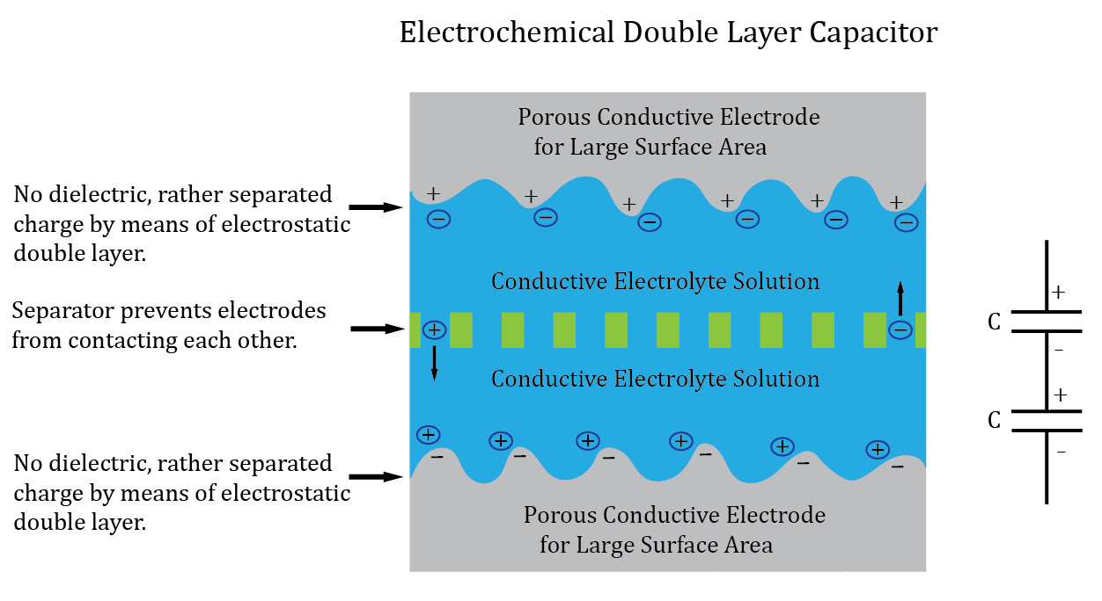
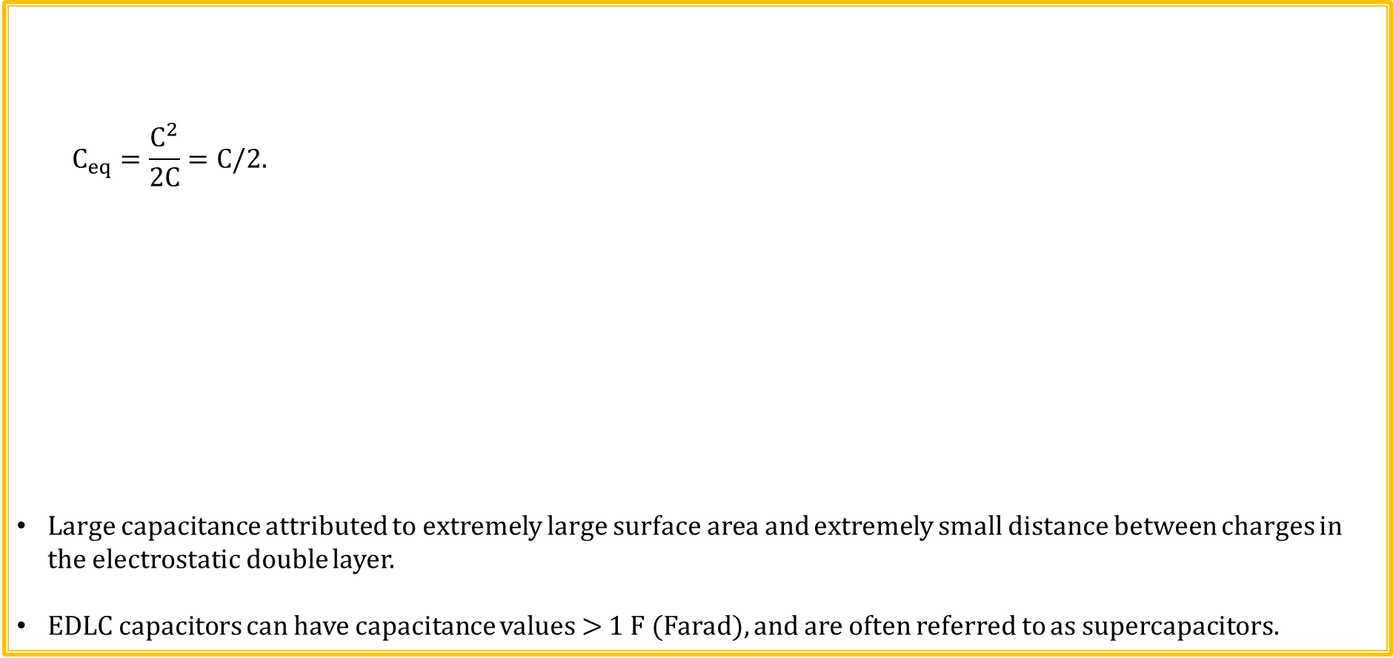
Electrochemical Double Layer Capacitors (EDLC)
$$C_{eq}=\frac{C^{2}}{2C}=C/2.$$
Large capacitance attributed to extremely large surface area and extremely small distance between charges in the electrostatic double layer.
EDLC capacitors can have capacitance values > 1 F (Farad), and are often referred to as supercapacitors.

Slide 16
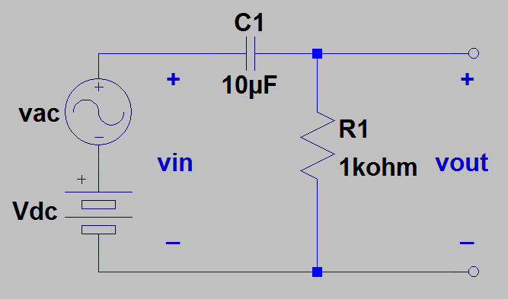
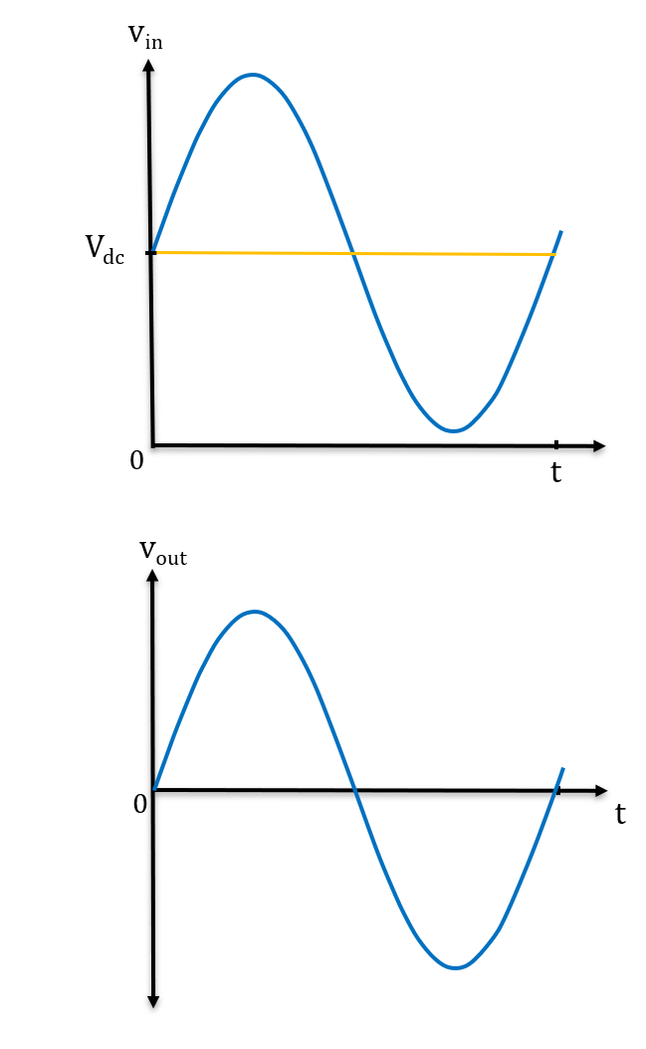
DC Blocking Capacitor
Given that v_{ac} is a high frequency ac signal, what does the output voltage v_{out} equal in the circuit below?
v_{out} = v_{ac}, because capacitors block constant dc voltages.
Can analyze this circuit using Superposition, separating out the
DC and AC supplies.
Oscilloscopes offer ac coupling, meaning that a large value capacitor is placed in series with the input to block constant dc voltages associated with the signal to be measured.

Slide 17
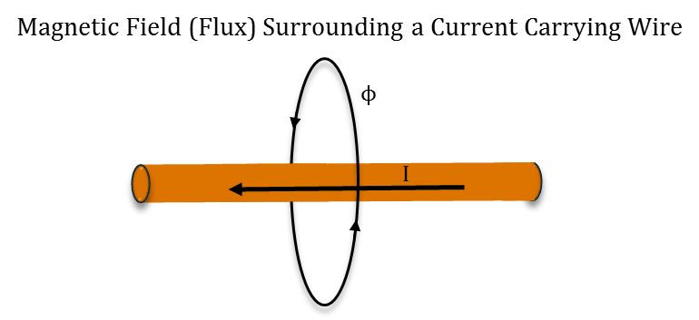
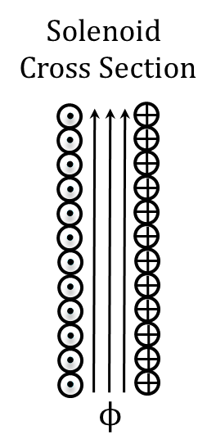
Electromagnetisms
Current flow in a conductor produces a
magnetic field around the conductor.
Electricity and magnetism are linked.
Right-hand rule - Point thumb in the direction of
current flow and curled fingers point in the direction
of magnetic lines of force.
Can concentrate magnetic field by utilizing coils of wire.
Solenoid → Helical coil electromagnet used to actuate
many electromechanical devices.
Solenoid works on constant dc currents, because
constant dc currents create a magnetic field.

Slide 18
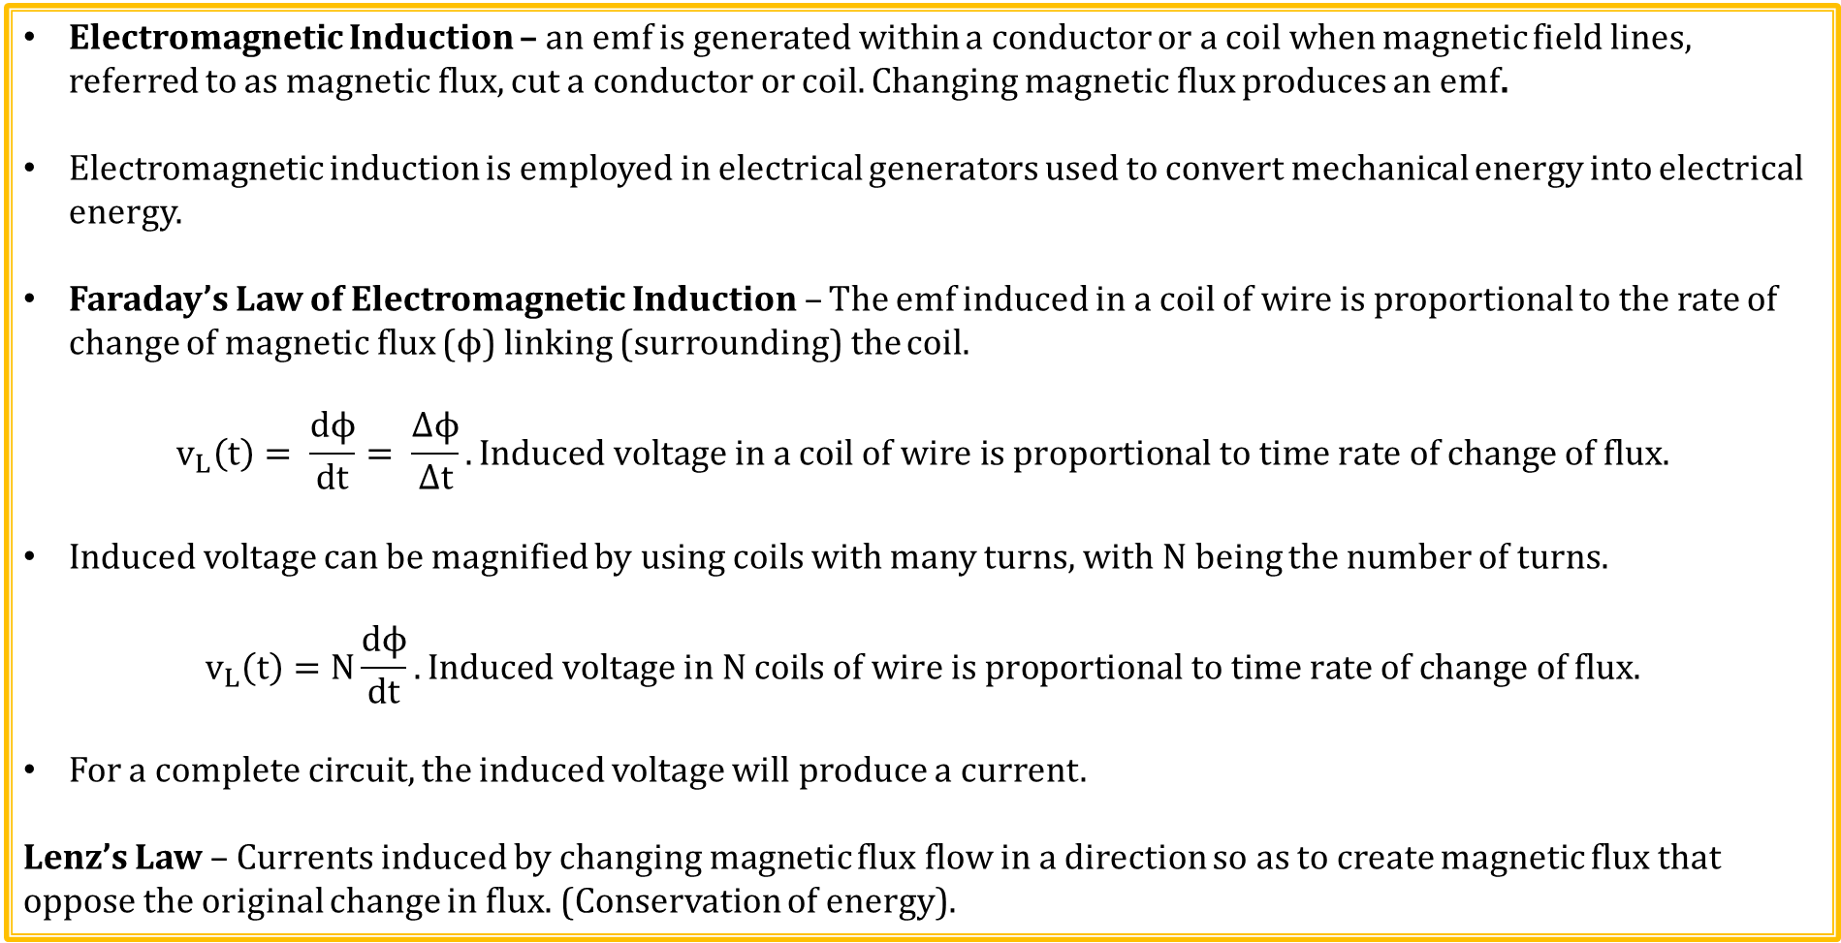
Electromagnetisms (Continued)
Electromagnetic Induction – an emf is generated within a conductor or a coil when magnetic field lines, referred to as magnetic flux, cut a conductor or coil. Changing magnetic flux produces an emf.
Electromagnetic induction is employed in electrical generators used to convert mechanical energy into electrical energy.
Faraday’s Law of Electromagnetic Induction – The emf induced in a coil of wire is proportional to the rate of change of magnetic flux ($ϕ$) linking (surrounding) the coil.
$$v_{L}\left(t\right)= \frac{dϕ}{dt}= \frac{Δϕ}{Δt}. Induced voltage in a coil of wire is proportional to time rate of change of flux.$$
Induced voltage can be magnified by using coils with many turns, with N being the number of turns.
$$v_{L}\left(t\right)=N\frac{dϕ}{dt}. Induced voltage in N coils of wire is proportional to time rate of change of flux.$$
For a complete circuit, the induced voltage will produce a current.
Lenz’s Law – Currents induced by changing magnetic flux flow in a direction so as to create magnetic flux that oppose the original change in flux. (Conservation of energy).

Slide 19
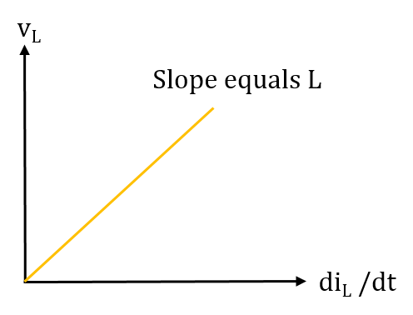
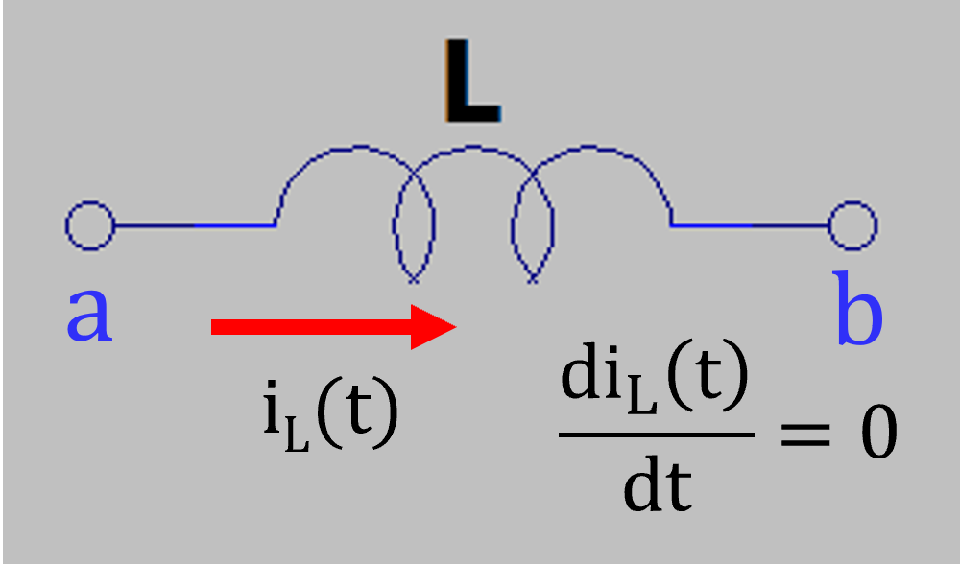
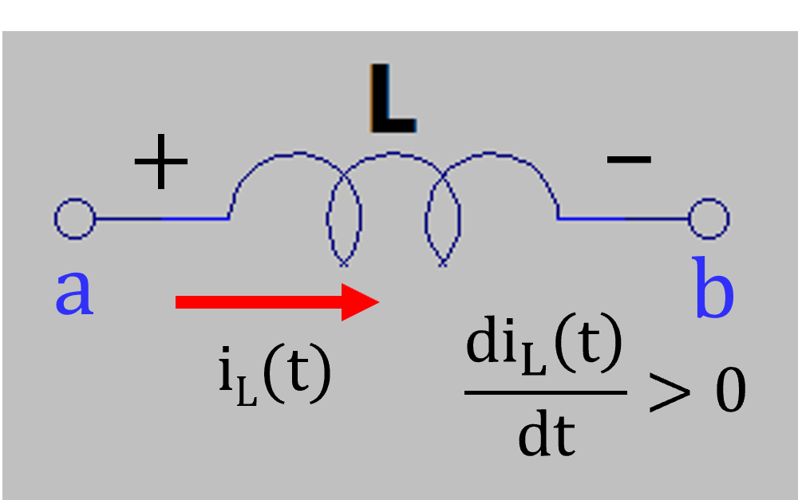
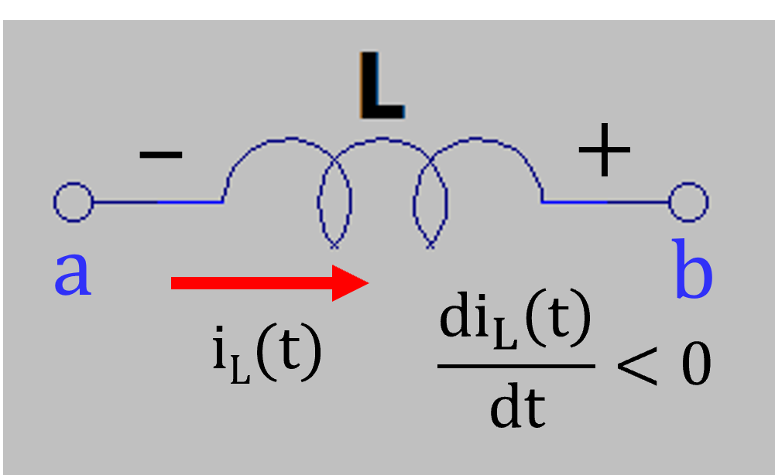
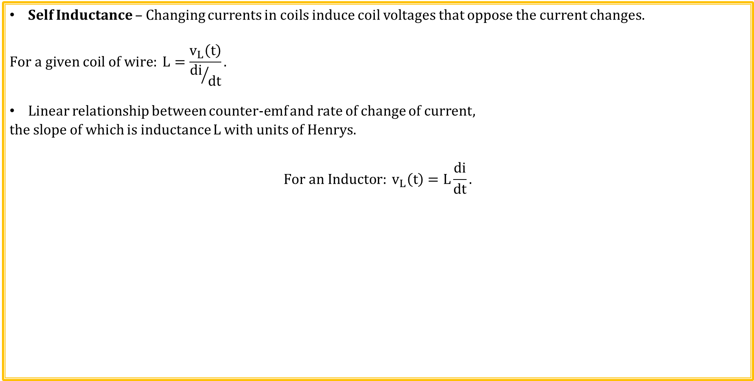
Inductance
Self Inductance – Changing currents in coils induce coil voltages that oppose the current changes.
$$For a given coil of wire: L=\frac{v_{L}\left(t\right)}{{di}/{dt}}.$$
Linear relationship between counter-emf and rate of change of current,
the slope of which is inductance L with units of Henrys.
$$For an Inductor: v_{L}\left(t\right)=L\frac{di}{dt}.$$
No Induced emf for di_{L}/dt = 0.
Induced emf for Increasing di_{L}/dt.
Induced emf for Decreasing di_{L}/dt.

Slide 20
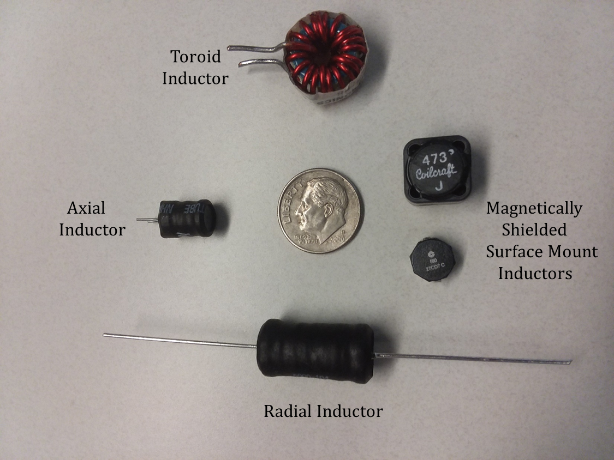
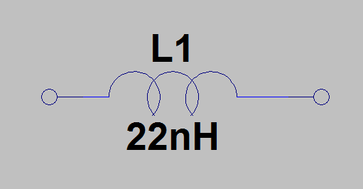
Inductors
An inductor consists of a coil of magnet wire (copper wire with insulating varnish coating), with or without a ferromagnetic core.
A current flowing through an inductor results in an associated
magnetic field, with electrical energy stored in the field.
Inductor Schematic
Symbol

Slide 21
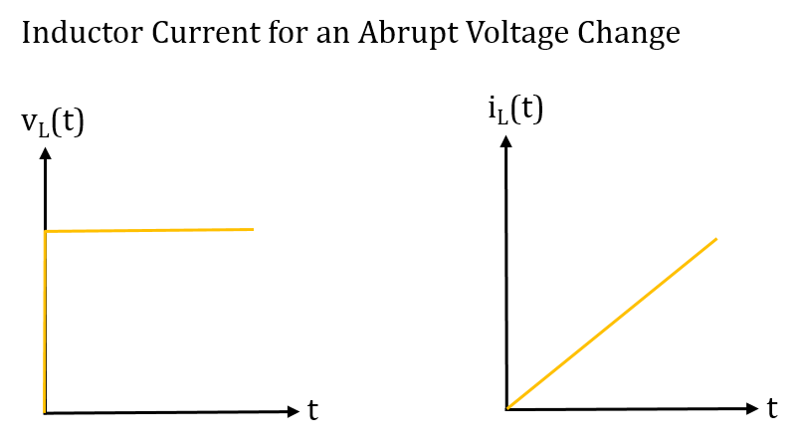
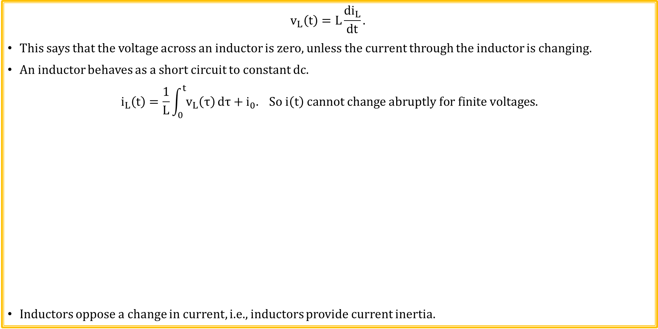
Inductor Voltage and Current
$$v_{L}\left(t\right)=L\frac{di_{L}}{dt}.$$
This says that the voltage across an inductor is zero, unless the current through the inductor is changing.
An inductor behaves as a short circuit to constant dc.
$$i_{L}\left(t\right)=\frac{1}{L}\int_{0}^{t}{v_{L}\left(τ\right)}dτ+i_{0}. So i\left(t\right) cannot change abruptly for finite voltages.$$
Inductors oppose a change in current, i.e., inductors provide current inertia.

Slide 22
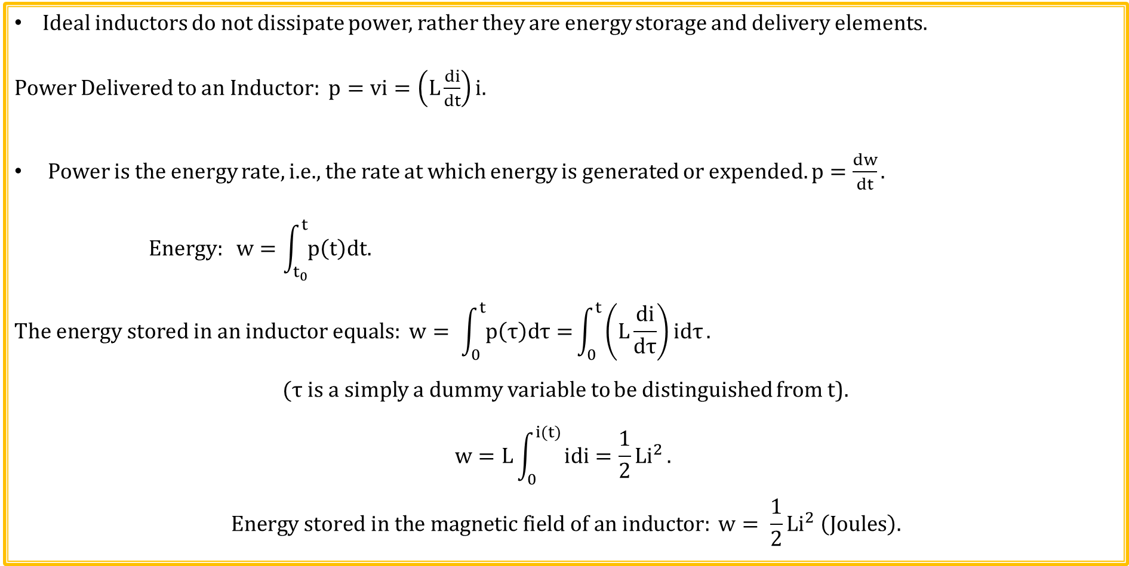
Inductor Energy Storage
Ideal inductors do not dissipate power, rather they are energy storage and delivery elements.
Power Delivered to an Inductor: $p=vi=\left(L\frac{di}{dt}\right)i.$
Power is the energy rate, i.e., the rate at which energy is generated or expended. $p=\frac{dw}{dt}.$
$$Energy: w=\int_{t_{0}}^{t}{p\left(t\right)dt.}$$
$$The energy stored in an inductor equals: w= \int_{0}^{t}{p\left(τ\right)dτ=}\int_{0}^{t}{\left(L\frac{di}{dτ}\right)idτ}.$$
$(τ$ is a simply a dummy variable to be distinguished from t).
$$w=L\int_{0}^{i(t)}{idi=\frac{1}{2}{Li}^{2}}.$$
$$Energy stored in the magnetic field of an inductor: w= \frac{1}{2}Li^{2} \left(Joules\right).$$

Slide 23
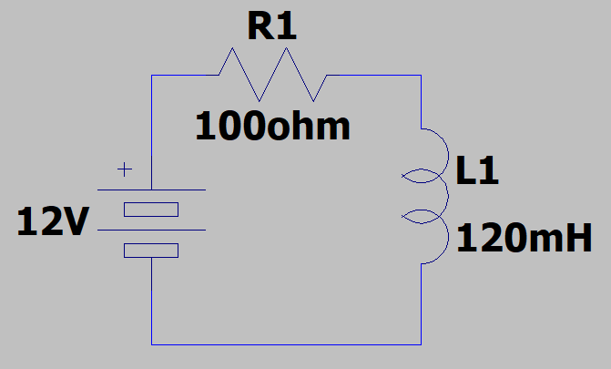
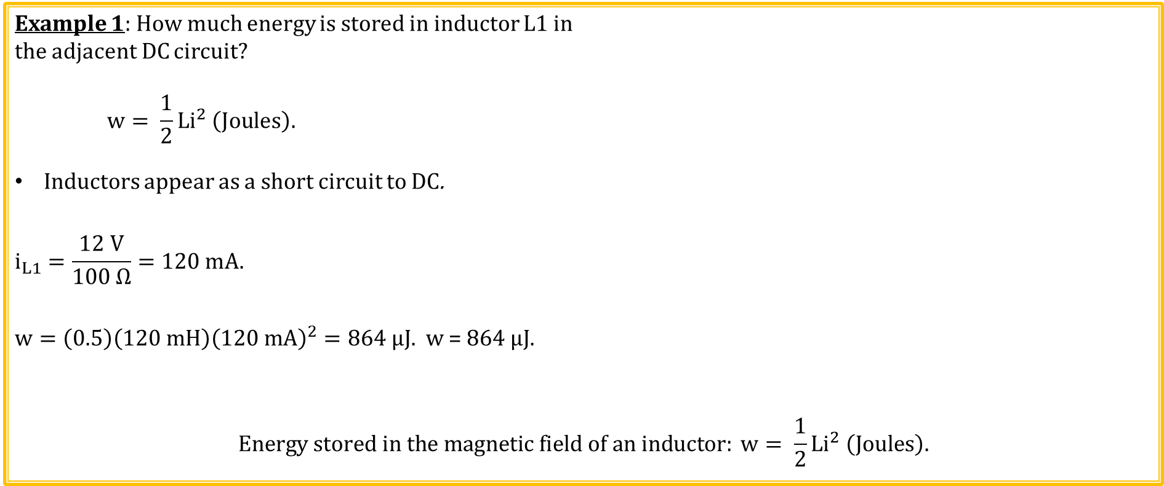
Inductor Energy Storage Example
Example 1: How much energy is stored in inductor L1 in
the adjacent DC circuit?
$$w= \frac{1}{2}Li^{2} \left(Joules\right).$$
Inductors appear as a short circuit to DC.
$$i_{L1}=\frac{12 V}{100 Ω}=120 mA.$$
$w=\left(0.5\right)\left(120 mH\right){\left(120 mA\right)}^{2}=864 µJ.$ w = $864 µJ.$
$$Energy stored in the magnetic field of an inductor: w= \frac{1}{2}Li^{2} \left(Joules\right).$$

Slide 24
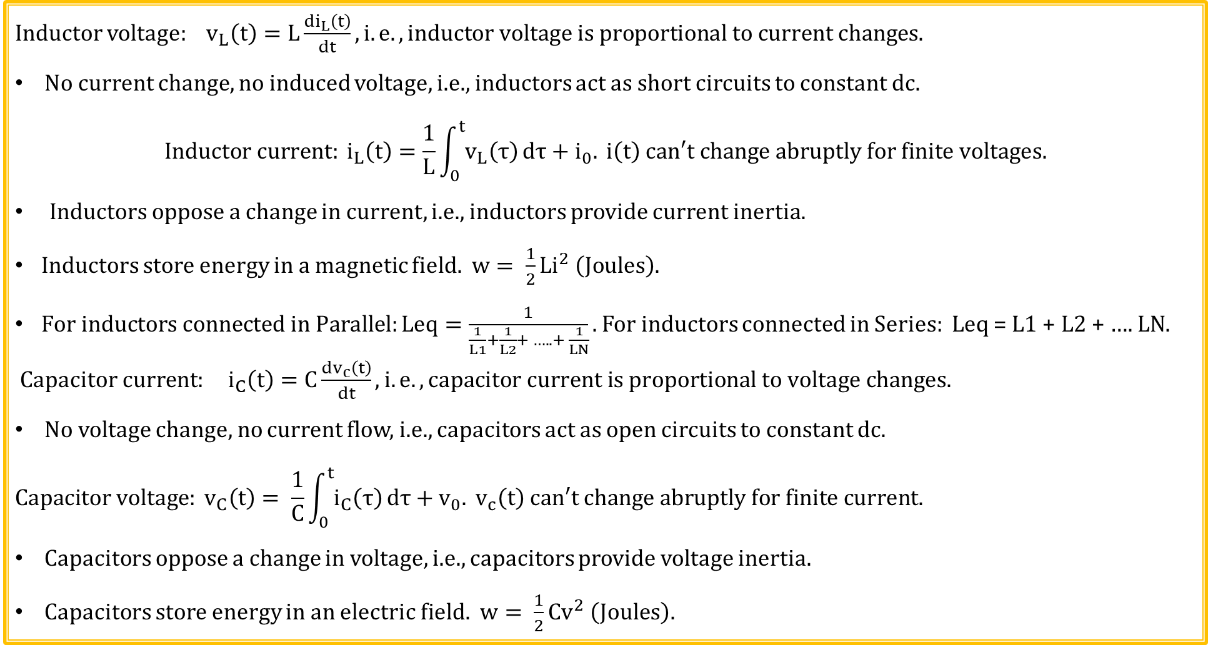
Inductor and Capacitor Summary
Inductor voltage: $v_{L}\left(t\right)=L\frac{{di}_{L}\left(t\right)}{dt}, i.e. ,inductor voltage is proportional to current changes.$
No current change, no induced voltage, i.e., inductors act as short circuits to constant dc.
$$Inductor current: i_{L}\left(t\right)=\frac{1}{L}\int_{0}^{t}{v_{L}\left(τ\right)}dτ+i_{0}. i\left(t\right) can′t change abruptly for finite voltages.$$
Inductors oppose a change in current, i.e., inductors provide current inertia.
Inductors store energy in a magnetic field. $w= \frac{1}{2}Li^{2} \left(Joules\right).$
$For inductors connected in Parallel:Leq=\frac{1}{\frac{1}{L1}+\frac{1}{L2}+ ….. + \frac{1}{LN}}.$ For inductors connected in Series: Leq = L1 + L2 + …. LN.
Capacitor current: $i_{C}\left(t\right)=C\frac{{dv}_{c}\left(t\right)}{dt}, i.e. ,capacitor current is proportional to voltage changes.$
No voltage change, no current flow, i.e., capacitors act as open circuits to constant dc.
$$Capacitor voltage: v_{C}\left(t\right)= \frac{1}{C}\int_{0}^{t}{i_{C}\left(τ\right)}dτ+v_{0}. v_{c}\left(t\right) can′t change abruptly for finite current.$$
Capacitors oppose a change in voltage, i.e., capacitors provide voltage inertia.
Capacitors store energy in an electric field. $w= \frac{1}{2}Cv^{2} \left(Joules\right).$
Poll Questions

Slide 25
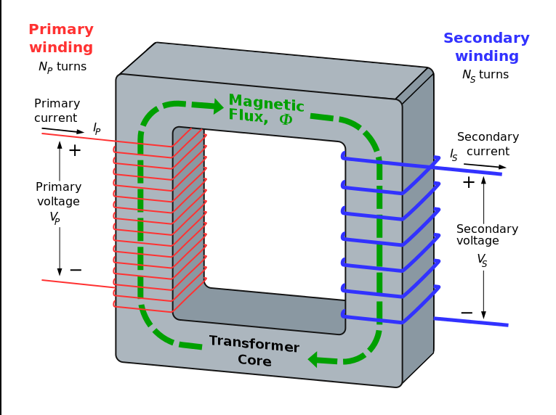
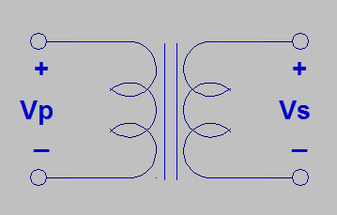

Transformers
Transformer: Magnetic circuit used for stepping AC voltages and currents up or down.
Magnetic flux is contained within high permeability core.
Changing (AC) primary current produces changing magnetic flux in the transformer core that induces a changing (AC) secondary voltage. Mainstream application of Faraday’s Law.
Why AC and not DC also?
Because changing flux is necessary for electromagnetic induction.
$$V_{p}=N_{p}\frac{dΦ}{dt}, V_{s}=N_{s}\frac{dΦ}{dt}, \frac{dΦ}{dt}=\frac{V_{p}}{N_{p}}=\frac{V_{s}}{N_{s}}.$$
$$\frac{V_{S}}{V_{P}}=\frac{N_{S}}{N_{P}}.$$
$$Ideally, P_{P}=P_{S}. V_{P}I_{P}=V_{S}I_{S}. I_{S}=I_{P}\frac{V_{P}}{V_{S}}=I_{P}\frac{N_{P}}{N_{S}}.$$
$$\frac{I_{S}}{I_{P}}=\frac{N_{P}}{N_{S}}.$$

Slide 26

Transformer Examples
By me (Photograph) [GFDL (http://www.gnu.org/copyleft/fdl.html), CC-BY-SA-3.0 (http://creativecommons.org/licenses/by-sa/3.0/) or CC BY-SA 2.5-2.0-1.0 (https://creativecommons.org/licenses/by-sa/2.5-2.0-1.0)], via Wikimedia Commons
Notes:
By me (Photograph) [GFDL (http://www.gnu.org/copyleft/fdl.html), CC-BY-SA-3.0 (http://creativecommons.org/licenses/by-sa/3.0/) or CC BY-SA 2.5-2.0-1.0 (https://creativecommons.org/licenses/by-sa/2.5-2.0-1.0)], via Wikimedia Commons

Slide 27


Transformer Examples (Continued)

Slide 28

Ignition Coil
The ignition coil is essentially a high-voltage step-up transformer made up of two coils of wire. One coil of wire is called the primary coil. Wrapped around it is the secondary coil. The secondary coil normally has hundreds of times more turns of wire than the primary coil. Current flows from the battery through the primary winding of the coil.
The key to the coil's operation is what happens when the circuit is suddenly opened by the points. The magnetic field surrounding the secondary coil changes rapidly, inducing very high voltage in the secondary coil, (greater than 20,000 volts) because of the number of coils in the secondary winding.
Ignition Coil Video. (4:06)
By Honda CB77 Restoration [CC BY 2.0 (http://creativecommons.org/licenses/by/2.0)], via Wikimedia Commons
Notes:
By Honda CB77 Restoration [CC BY 2.0 (http://creativecommons.org/licenses/by/2.0)], via Wikimedia Commons

Slide 29
The End

Slide 30

Capacitors and Inductors
Why does a capacitor oppose changes in voltage?
Because voltage changes across a capacitor results in current flow to or from the capacitor, which limits the abruptness of the voltage change. Charge has to transfer before the voltage across the capacitor can change and this takes time.
$$Capacitor voltage: v_{C}\left(t\right)= \frac{1}{C}\int_{0}^{t}{i_{C}\left(τ\right)}dτ+v_{0}. v_{c}\left(t\right) can′t change abruptly for finite current.$$
The voltage across a capacitor cannot change instantaneously.
$$Inductor current: i_{L}\left(t\right)=\frac{1}{L}\int_{0}^{t}{v_{L}\left(τ\right)}dτ+i_{0}. i\left(t\right) can′t change abruptly for finite voltages.$$
Why does an inductor oppose changes in current?
Because a current change in an inductor results in a changing magnetic flux, which then produces a counter emf that opposes the change in the current.
The current through an inductor cannot change instantaneously.

Slide 31
Extra

Slide 32

American Wire Gauge Wire Sizes
Increasing gauge number denote decreasing wire diameters.
Smaller gauge number wire can conduct larger currents.
Stranded copper wire often used for heavy gauge as it bends easier.
Want to choose the correct AWG number to handle largest expected current.
Notes:
Graphic by BYU-Idaho Campus Curriculum Development in Illustrator

Slide 33


Series Capacitors
Series capacitors all have the same current $i\left(t\right)=C\frac{dv}{dt}$,
and therefore the same charge. Connected plates between
C1 and C2 and C2 and C3 have equal and opposite charge
on the connected plates.
Applying KVL: v_{s} = v_{C1} + v_{C2} + v_{C3}. v_{c} = q/C.
$${So v}_{s}=q/{C1}+q/{C2}+q/{C3}. Also v_{s}={q_{eq}}/{Ceq=q/{Ceq}}.$$
$$v_{s}=\frac{q}{C_{eq}}=\frac{q}{C1}+\frac{q}{C2}+\frac{q}{C3}=q\left[\frac{1}{C1}+\frac{1}{C2}+\frac{1}{C3}\right]. \frac{1}{C_{eq}}=\frac{1}{C1}+\frac{1}{C2}+\frac{1}{C3}.$$
$${For N series capacitors: C}_{eq}=\frac{1}{\frac{1}{C1}+\frac{1}{C2}+ ….. + \frac{1}{CN}}.$$
Equivalent capacitance of series capacitors is smaller than the smallest capacitance.

Slide 34

Inductor Summary
$For a given coil of wire: L=\frac{v_{L}\left(t\right)}{{di}/{dt}}.$
Inductors store energy in a magnetic field. $w= \frac{1}{2}Li^{2} \left(Joules\right).$
$For inductors connected in Parallel:Leq=\frac{1}{\frac{1}{L1}+\frac{1}{L2}+ ….. + \frac{1}{LN}}.$
Equivalent inductance of parallel inductors is smaller than the smallest inductor.
For inductors connected in Series: Leq = L1 + L2 + …. LN.
Series inductors increases energy storage for a given current, i.e., increases inductance.
Why do inductors oppose a change in current?
$$Mathematically i_{L}\left(t\right)=\frac{1}{L}\int_{0}^{t}{v_{L}\left(τ\right)}dτ+i_{0}. So i_{L}\left(t\right) can′t change abruptly for finite voltages.$$
Physically, because a current change in an inductor results in a changing magnetic flux, which induces a counter emf opposing the original current change.

Slide 35

Capacitors and Inductors
Capacitor current: $i_{C}\left(t\right)=C\frac{{dv}_{c}\left(t\right)}{dt}$.
Capacitor current proportional to voltage changes.
No voltage change, no current flow, i.e., capacitors block constant dc voltages.
$$Capacitor voltage: v_{C}\left(t\right)= \frac{1}{C}\int_{0}^{t}{i_{C}\left(τ\right)}dτ+v_{0}. v_{c}\left(t\right) can′t change abruptly for finite current.$$
Capacitors oppose a change in voltage, i.e., capacitors provide voltage inertia.
Inductor voltage: $v_{L}\left(t\right)=L\frac{{di}_{L}\left(t\right)}{dt}$.
Inductor voltage proportional to current changes.
No current change, no induced voltage, i.e., inductors act as short circuit to constant dc.
$$Inductor current: i_{L}\left(t\right)=\frac{1}{L}\int_{0}^{t}{v_{L}\left(τ\right)}dτ+i_{0}. i\left(t\right) can′t change abruptly for finite voltages.$$
Inductors oppose a change in current, i.e., inductors provide current inertia.
Poll Questions

